Slide 1
Final Year Project On
NIDU
UNDER GUIDANCE OF: Mr.- ANIL SINGH
TEAM MEMBERS:
PRINCY VARMA(1834210069) TRIPTI SHARMA (1834210102) SHAKSHI SHARMA (1834210081)
VEDPRAKASH PANDEY (1903420109001)

Slide 2
Flow of Presentation
Introduction
Why we made this project
Methodology
Modules
Scope
Required input
E-R diagram
Advantages
Future enhancement
Work progress….

Slide 3
Introduction
“NIDU” is builds, repair, construction, service software for the user. The project “NIDU” is developed in Web Application and Mobile Application which mainly focuses on the basic operation in an application like adding a new member, new multi services, add location, updating new information, searching services, take services and give services. Design to help the user maintain and organize the application easily. Our software is easy to use for both beginner and advance users, it features a familiar and well-thought-out, attractive user interface, combined with strong searching, insertion, creation and reporting capabilities. The searching and creating facilities of an application system help users to find the best service or best way to earn.

Slide 4
Why we made this project
India is the biggest hub of working services. The worker works in different fields but still, the workers are unable to find the work which they want and most the people are not able to find workers according to their needs. As a result, we see unemployment everywhere, to decrease the unemployment we just try to manage problems which are facing by both workers and people by our project.

Slide 5
Methedology
Our project works on following methodology:
Front-End: HTML (Hypertext Marker Language), CSS (Cascading Style Sheets), JavaScript, React.
Back-End: Node.js , SQL (Structured Query Language), MongoDB.

Slide 6
Modules
The NIDU has four main modules-
• Search facility by location, photos and text
• Calling service for registration the job notification for workers (USSD)
• Insertion to database module-user friendly input screen
• Extraction from database module-attraction output screen

Slide 7
Scope
The scope of this project is as follows:
❖ To assist the workers in capturing the efforts spent on their respective areas
❖ To utilize resources in an efficient manner by increasing their productivity through automation
❖ The system generates types of information that can be used for various purposes
❖ It follows the quotes a friend in need a friend in deed

Slide 8
Required Input
All the input required for the development of this project are-
Electrician
PLUMBER
LABOR
PAINTER
CARPENTER
INTERIOR DESIGN
TILING
MASONRY
CLEANING

Slide 9
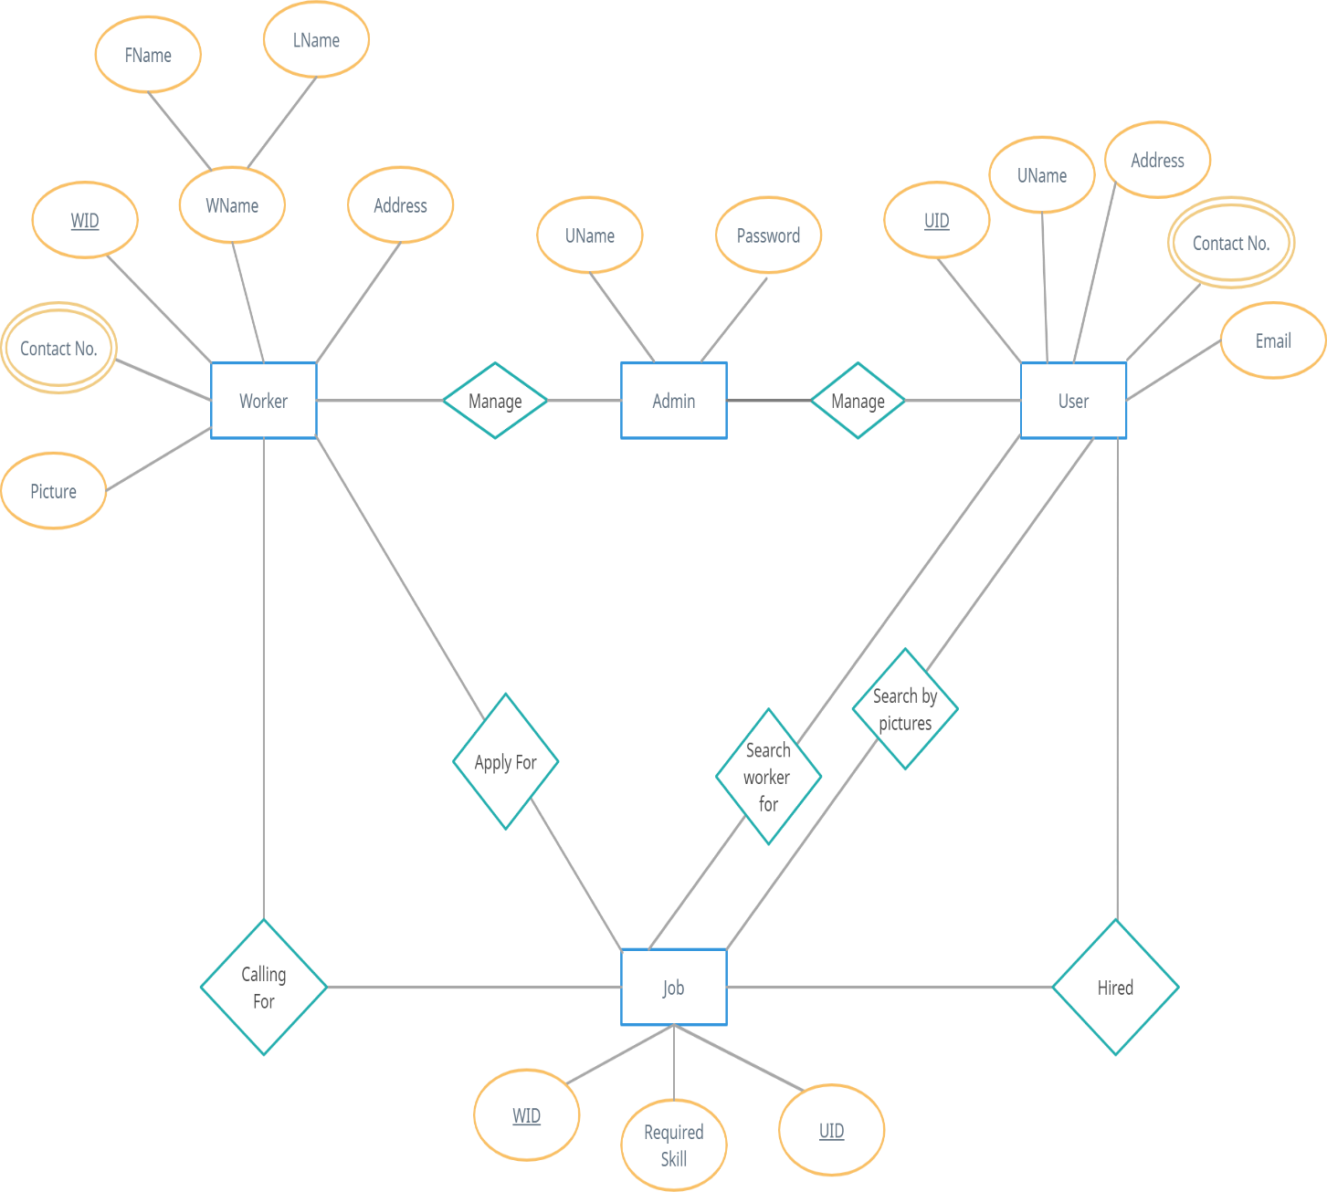
E-R Diagram

Slide 10
Advantages
To reduce unemployment
Helpful for all the situations(pandemic)
Worker can easily get their job according to their skill
Job availability is more
People can easily rate the workers

Slide 11
Future Enhancement
We can add more skilled labour
We can established good relationship with both sectors private as well as government
Anyone can get a job
People can get the workers rapidly

Slide 12
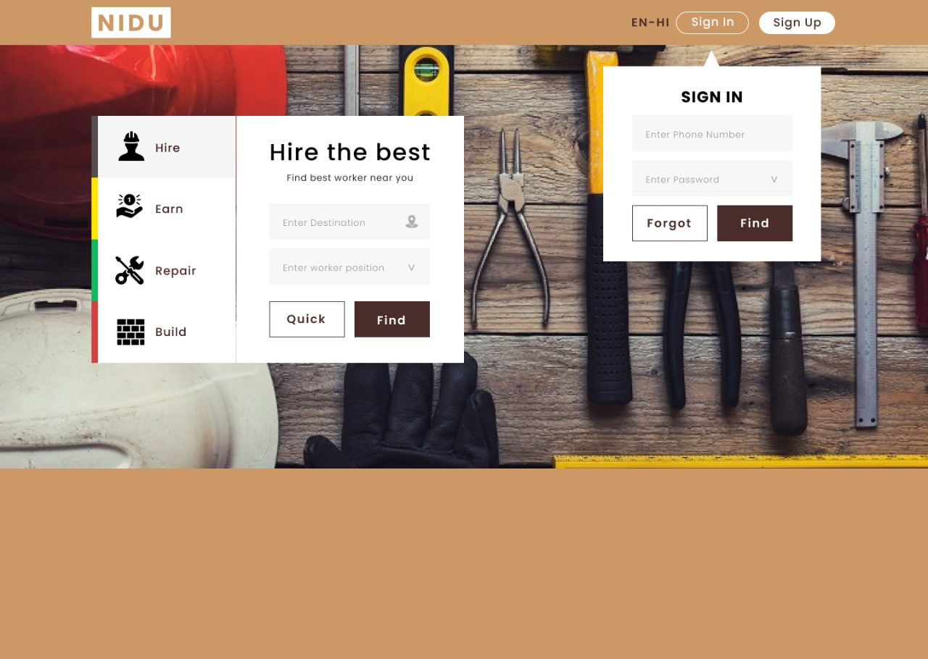
Work progress….

Slide 13
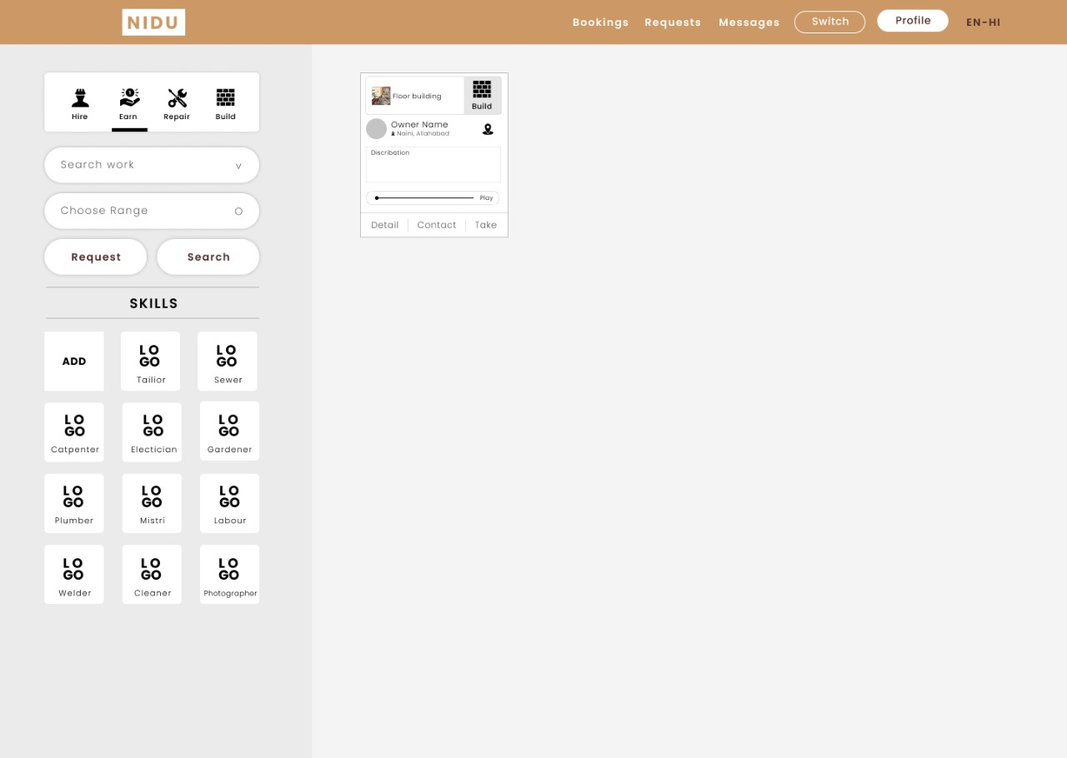

Slide 14
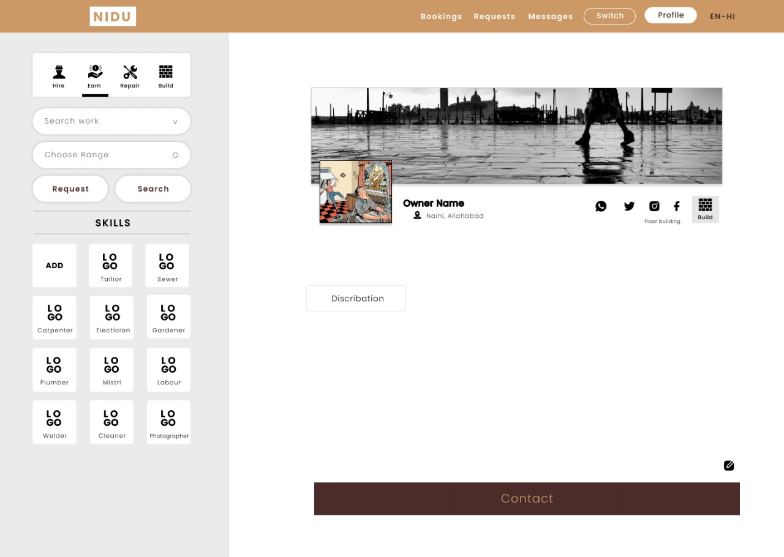

Slide 15
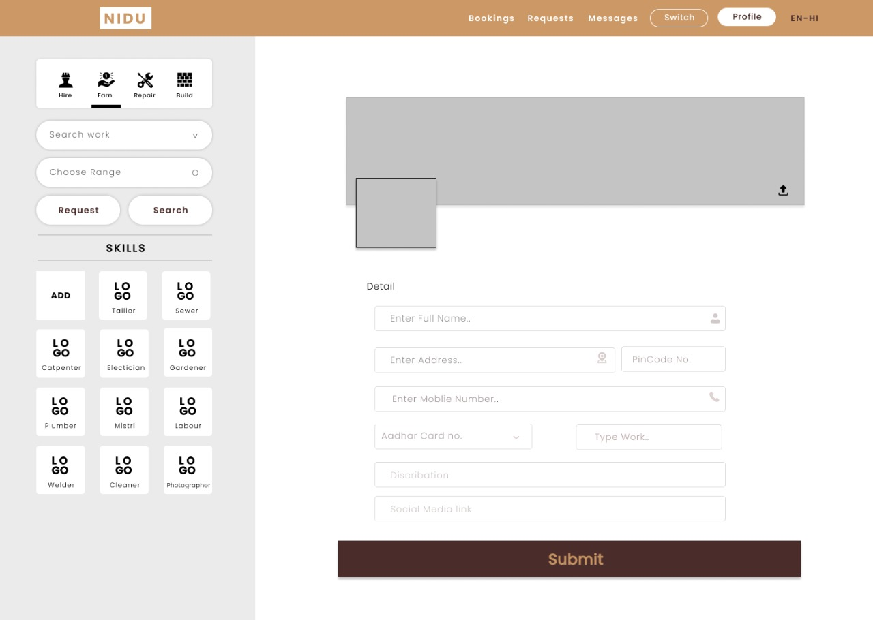

Slide 16
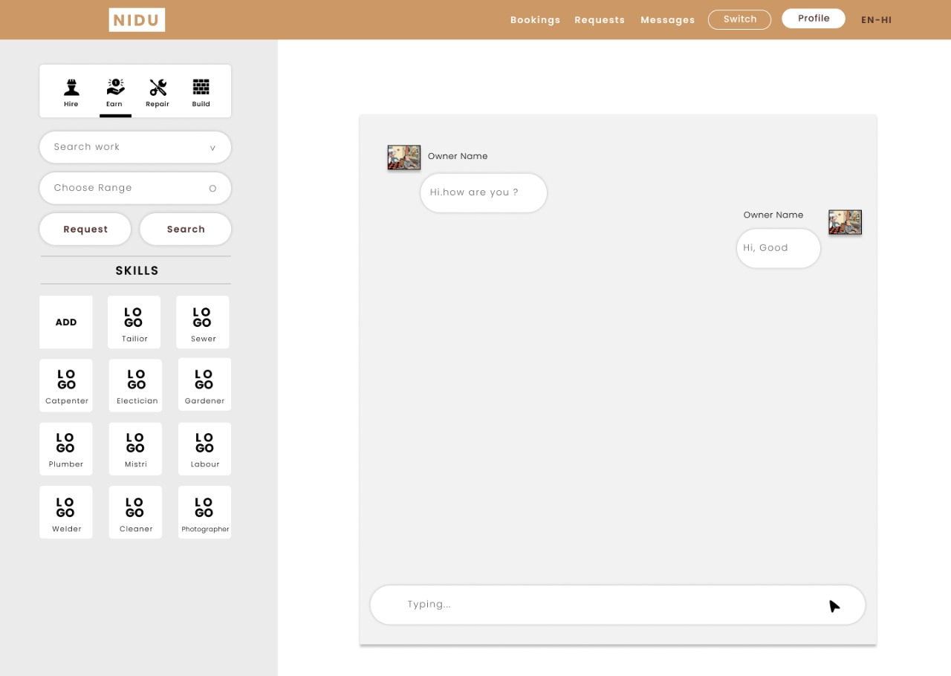

Slide 17
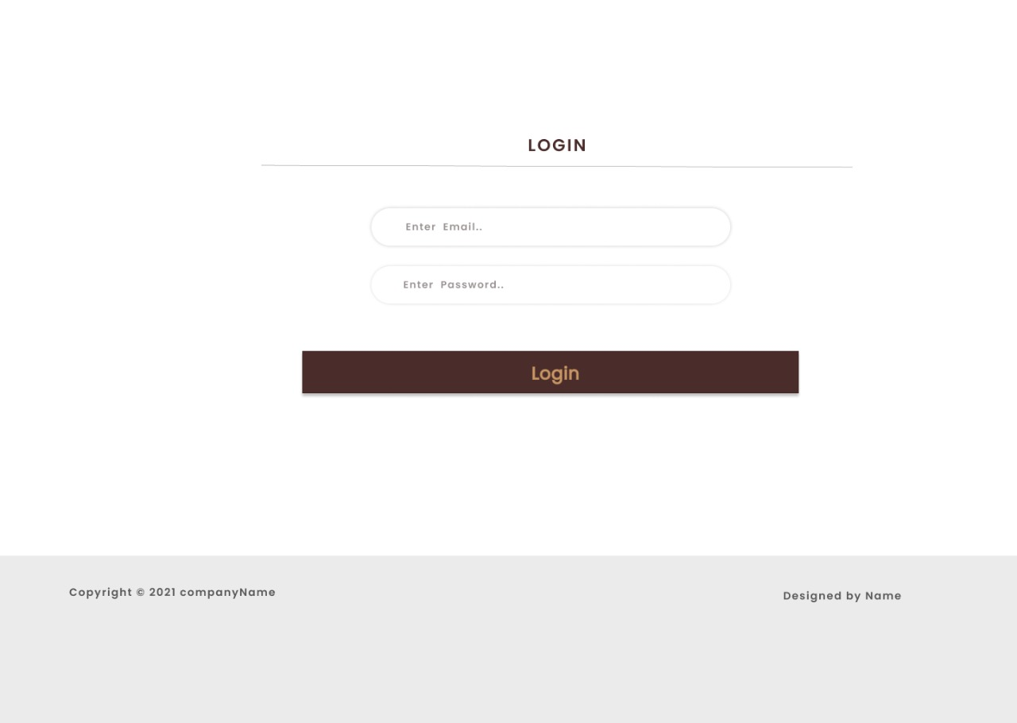

Slide 18
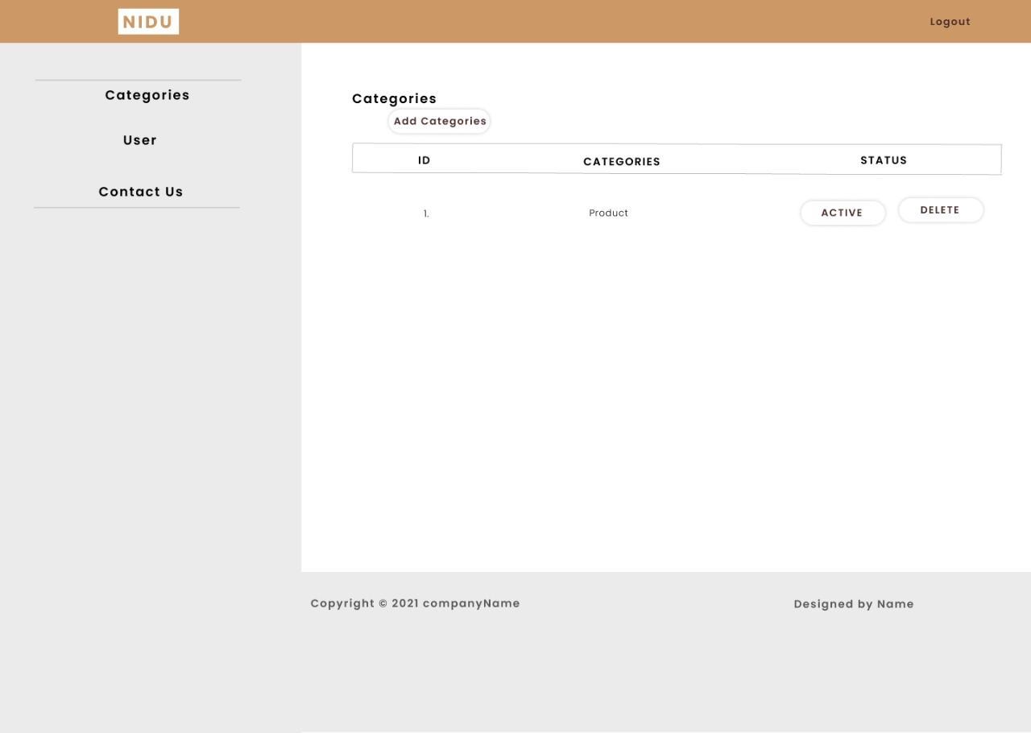

Slide 19
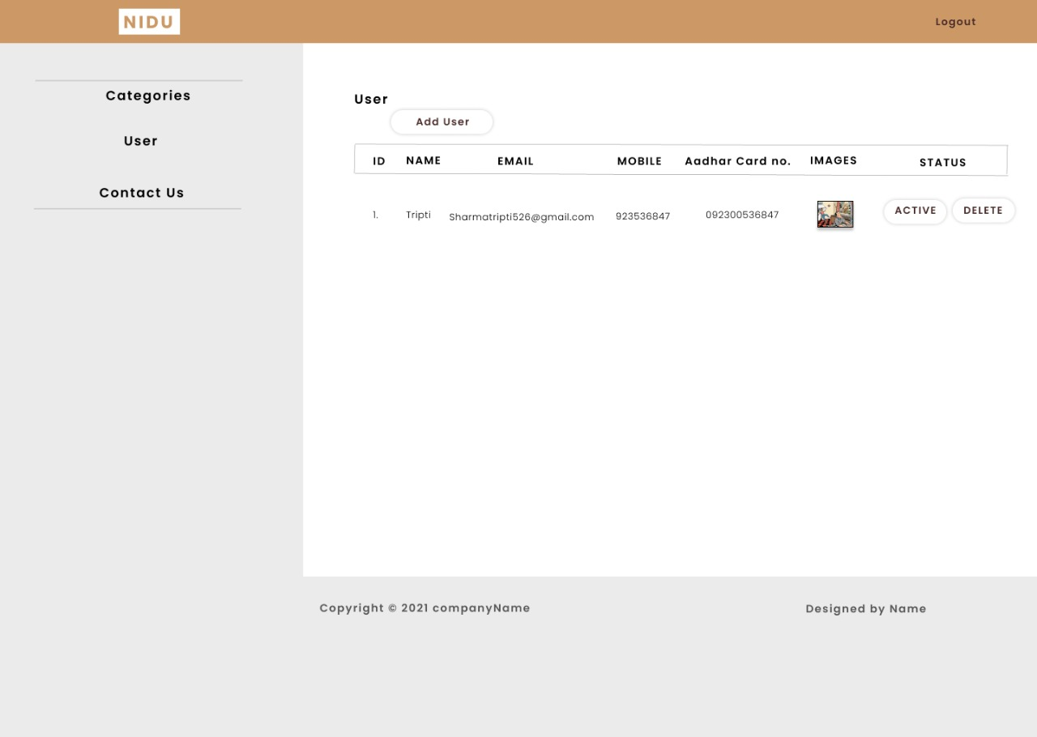

Slide 20
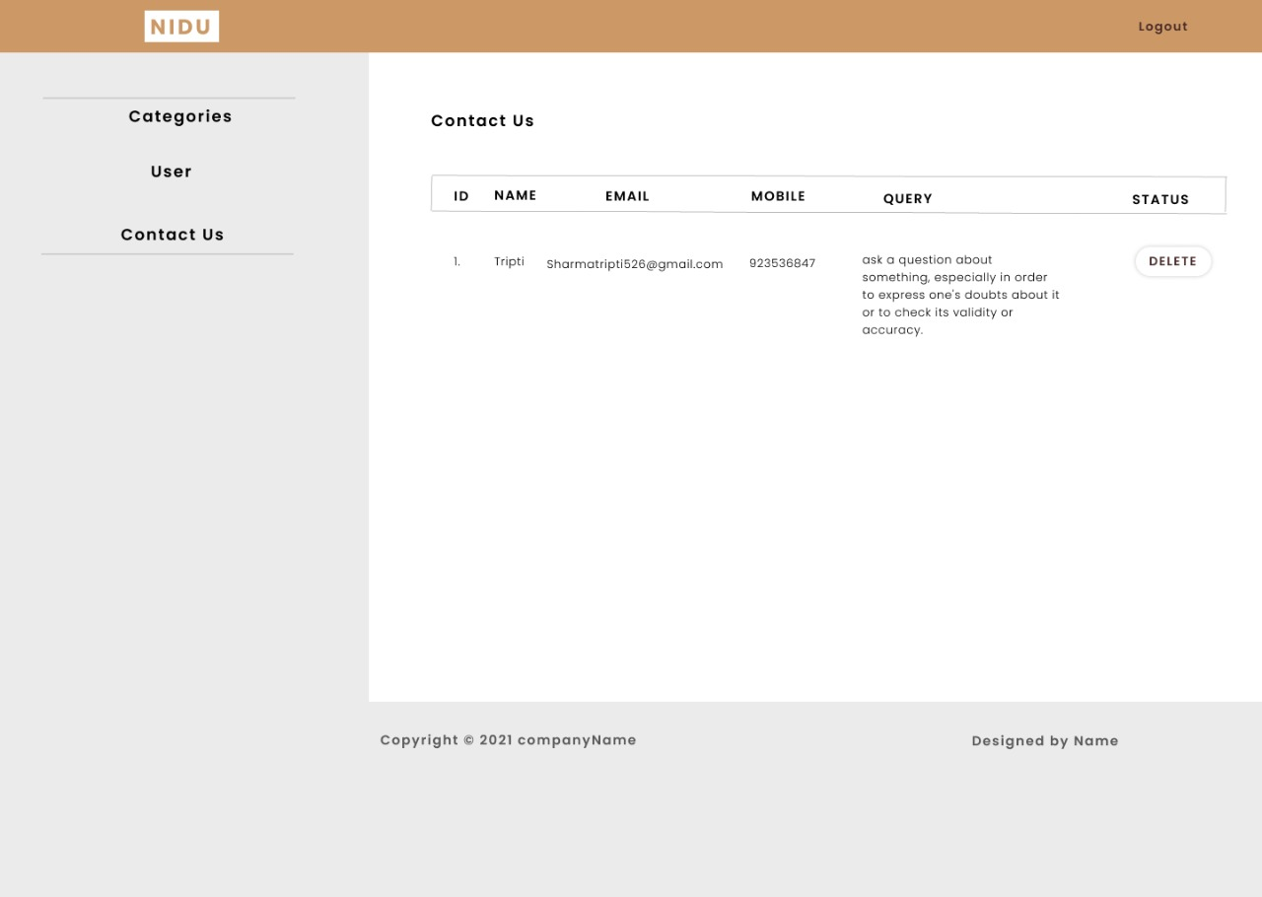

Slide 21
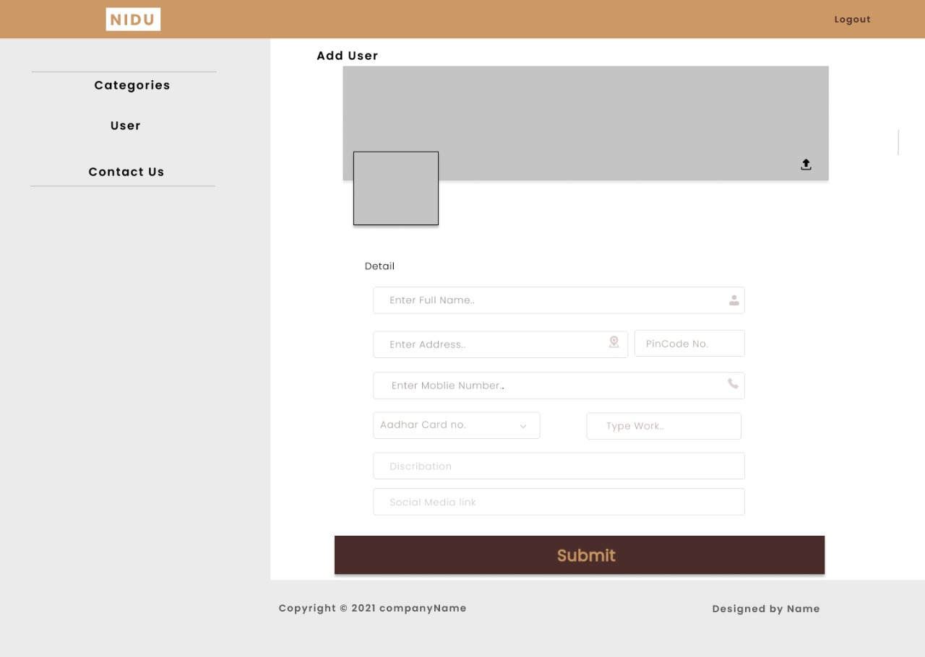

Slide 22
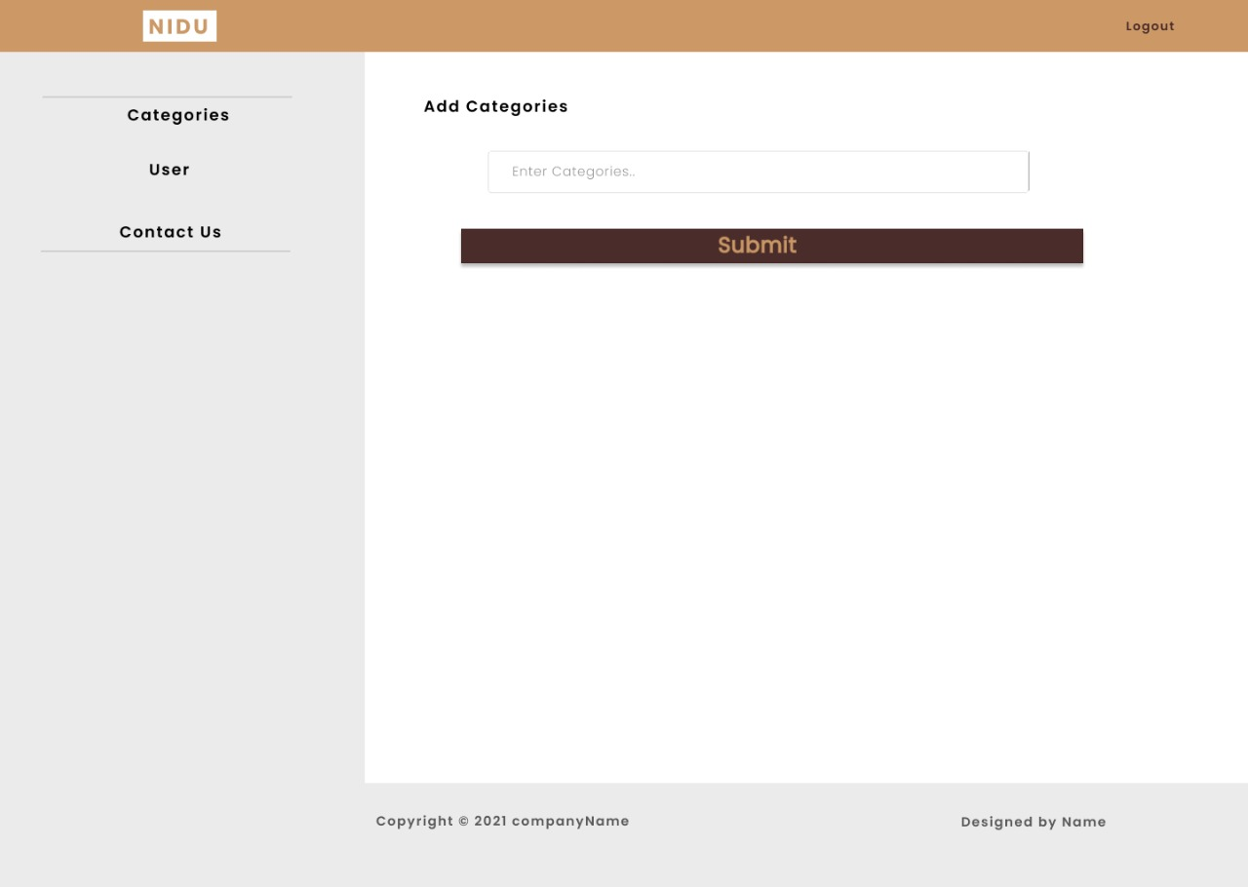

Slide 23
Thank You

